Slide 1

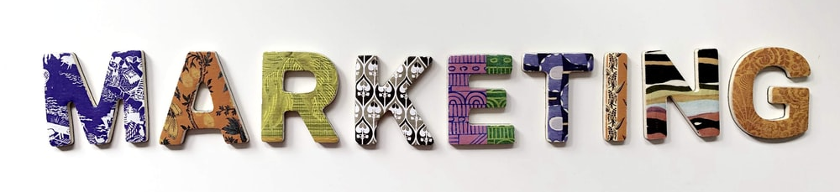
Foundations of Entrepreneurship
Rejendra Mishra School of Engineering Entrepreneurship, IIT Kharagpur
Topic: Marketing for Startups
Lecture Note #: 17 18.02.2021

Slide 2
Brand Power
iPhone parts cost ₹ 30,000
It is sold for ₹ 80,000

Slide 3



Trend: Selecting business model based on TREND
Trend provides great opportunity for starting new & winning ventures.
Those who are ahead of the trend or at least at the forefront of the trend, tend to enjoy natural advantages.
Therefore, it is important to be able to forecast the technology trend, fashion trend, social trend, lifestyle, economic and environmental trend for creation of attractive new businesses

Slide 4
Recent trends defining the opportunity landscape
Green
Clean energy
Organic orientation
Economic
Social
Healthcare
Web
Analytics
IoT
FinTech
Digital wallet
Digital currency (cryptocurrency
Robotics
Drone based technologies
Artificial intelligence, machine learning
Energy storage – Battery technology, Super capacitor /Ultra capacitor
Electric vehicles
Block chain
E-commerce
Digital communication (5G)
Quantum computing
Smart irrigation
Virtual reality (VR)/Augmented reality (AR)
Additive manufacturing
Serverless computing

Slide 5
Trend is driven by
Technology trend or emergence – 5G, Autonomous, E-Vehicle, CC
Social change – retail, smart home
Environmental change – global warming, pandemic
Economic change – decentralizing financial services
Fashion – media

Slide 6
Define marketing
Overview on marketing
Digital marketing
Market segmentation, target marketing, and product positioning.
Marketing mix

Slide 7
Marketing starts from the time of identifying a pain point and continues as long as the company remains a going concern.
Marketing is about building relationship with customers through a strong brand, reaching to increasing audience to acquire and retain satisfied customers, establishing credibility/trust, and building a satisfied & loyal customer base.
The best product does not always win.
The best marketing does. - Steve Denning
Notes:
You narrative should resonate with people and people should find utilities in your narrative.

Slide 8
Marketing is relevant and critical at every conceivable phase in the life of a new venture
Sustain
Growth
Commercial operation
Go-to-market
Refine prototype
Marketing
Marketing
Validation
Marketing
Marketing
Marketing
Marketing
Marketing
Marketing
Marketing
Prototype
Define
Phases in the life of a venture
Idea

Slide 9
Marketing
Social definition
Marketing is a societal process by which individuals and groups obtain what they need and want through creating, offering and freely exchanging products and services of value with others.
Peter Drucker
The aim of marketing is to make selling superfluous. The aim of marketing is to know and understand the customer so well that the product or service fits him and sells itself.
American Management Association
Marketing management is the process of planning and executing the conception, pricing, promotion, distribution of ideas, goods, services to create exchanges that satisfy individual and organizational goals.
Phillip Kotler
We see marketing management as the art and science of choosing target markets and getting, keeping and growing customers through creating, delivering and communicating superior customer value.

Slide 10


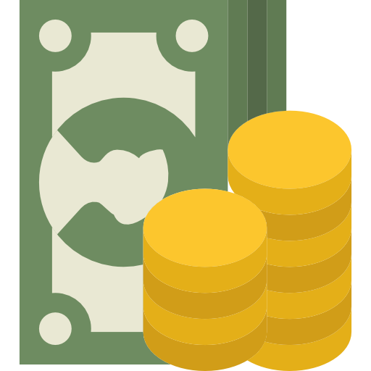
People at large/
Whole market
Awareness
Market segment
Prospect
Interest
100
Consideration
Lead nurture
75
Intent
50
Evaluation
Sales
Marketing funnel
25
Purchase
Output
Reference
Virality

Slide 11

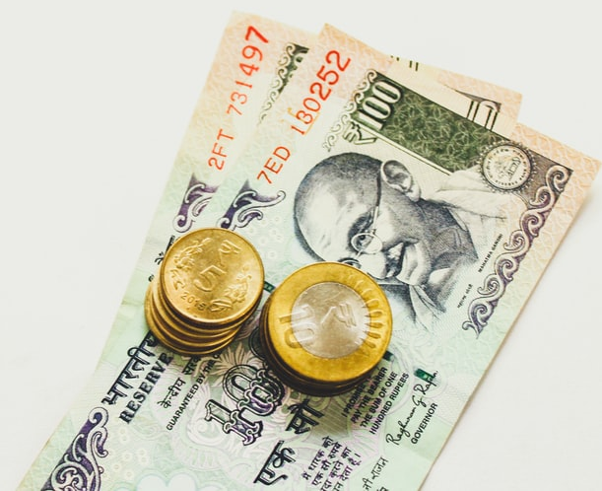
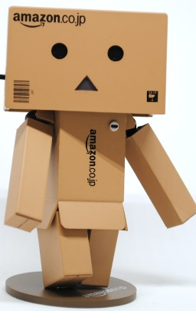
Marketing and Selling
Sales is the action that converts goods into cash
Awareness
Intent
Interest
Purchase
Consideration
Evaluation
Marketing is selling through creation of a sustainable & satisfying relationship with customers
Marketing | Sales

Slide 12






Marketing is a Process by Which Companies -
1. Convey the value proposition to market segment.
2. Create value for customers – both perceived and real.
3. Build strong customer relationship – your story should resonate with customers
4. Understand changing needs and choices.
5. Refine or redesign products and services to meet them to give customers a sense of higher value.
6. Build strong brand by establishing emotional connectivity with customers. Create premium brand equity and gain pricing power.
7. Create value for stakeholders and sustain for a long time.

Slide 13
Goals Marketing helps to
01
know who are the customers and what are their attitudes, behaviour, needs and beliefs? What are their expectations?
discover their persona and how to resonate with that.
know which of their unique needs and aspirations can be fulfilled.
discover how to design value proposition to attract them?
attract new customers by promising superior value.
keep current customers and grow by delivering satisfaction.
02
03
04
05
Notes:
These are questions that marketers have wrestled with since the beginning of time.

Slide 14
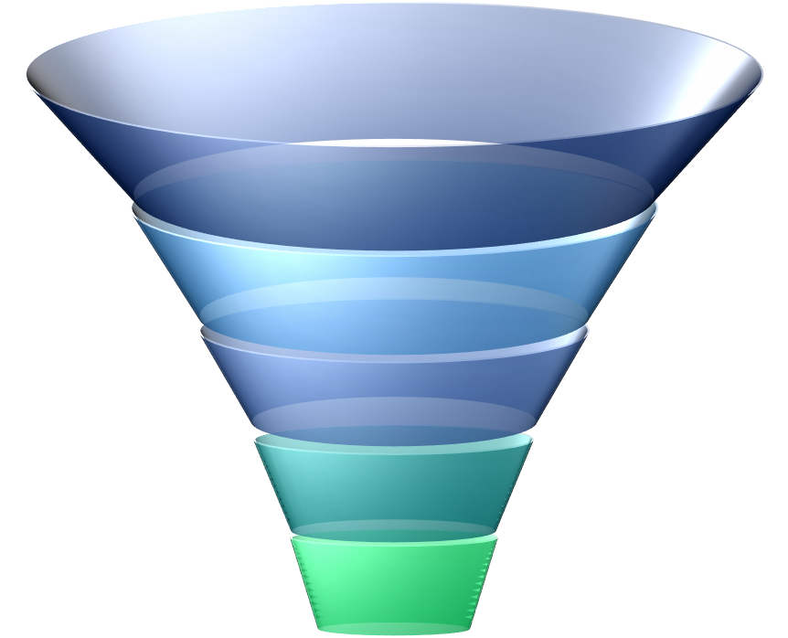
Marketing Tools
Branding
PR
Advertising
Content marketing
Pricing
Messaging
Online presence
Social media
Influencer marketing
Market research
Selling

Slide 15
Branding
Brand is your promise, and customers’ trust on it, to your customers about superior performance of a product or service compared to that of the competitors and customers’ level of trust on your promise.
A brand is like a channel of communication. Having a strong brand indicates that you have a group of loyal customers who repeatedly buy your product. Stronger the brand, deeper is the relationship and commitment to your products and lower is the risk of your business.
A brand may represent a low-cost medium performance product or a high-cost premium one or anything in between.
Thus, brand represents a promise of certain quality, trust, performance, and reliability.

Slide 16
Branding
is the process of building trust in customers’ mind on a product, service or the company as a whole by promising certain values and delivering better than what is promised.
The goal is to establish a positive impression in the minds of consumers to attract and retain loyal customers.
Branding needs to deliver values and to communicate it through various marketing media such as advertisement and promotion.

Slide 17
Brand
Branding has two definite components: one rational (tangible: quality, features, price), and the other, emotional (Intangible: mental image, esteem, trust, experience, meaning).
It has been proven that many customers become passionate on certain brands though they cannot make distinction in blind tests.
By showing association of celebrities with a product or company, companies try to create perception in peoples’ mind about quality, trust, and esteem. It is also a process of co-sharing of brand equity. For example, Nike associates its products with star athletes.

Slide 18


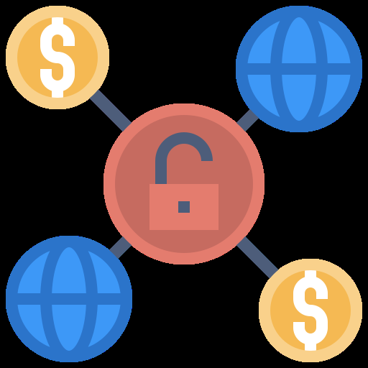

Building a Strong Brand
Design a compelling story. Advertise to create awareness.
Use the story to engage consumers and elicit emotion to foster loyalty, forging a meaningful relationship that goes far beyond product and service.
Storytelling is a powerful and effective way to make emotional connection & build lasting relations with your audience.
Use promotion to call-to-action with an offer that they can’t refuse.
Over-deliver on your promise and give unexpected satisfaction.

Slide 19
Example of Brand Storytelling: Huggies
In Canada, Huggies was pitted against Pampers, which had 100% market share in Canadian hospitals.
Competing with Pampers they needed to provide tangible & emotional reasons for mothers to choose them before arriving at the hospital to give birth.
The answer was found in their name: Hugs
Research has proven hugs help stabilize babies’ vital signs, build immune systems, ward off illness, and improve brain development.
The brand went on a mission to leave no baby un-hugged.

Slide 20
The campaign hinged on two initiatives
They educated mothers on the benefits of skin-to-skin contact with their babies.
Motivated Canadian hospitals to have volunteer ‘huggers’ for babies in need of hugs.
They achieved growth much higher than industry average, huge engagement rate, and have emerged as a lead brand against all odds.
Amul, Nestle chocolate, and many more are increasingly adopting content marketing strategies.
The trend is increasingly moving towards content rather than advertisements.

Slide 21
Brand Equity
Strong brand means high brand equity.
Brand equity is the premium commercial value that can be derived from consumers’ loyalty to it and the emotional attachment.
The value depends on how strong is the loyalty and the number of loyal people who are loyal.
Branding is the process of creating lasting connectivity with customers. The process creates a unique impression for a product in the consumers' mind, mainly through storytelling through advertising campaigns.
Branding aims to establish a significant and differentiated presence in the market that attracts and retains loyal customers.
Companies with strong brands enjoy premium valuation in the market.
Each rupee of profit is valued:- RIL: ₹24, Marico: ₹ 42, ITC: ₹ 30, Nestle: ₹ 88, HindUnilever: ₹ 92, P & G: 94

Slide 22
Airbnb
Founded in 2008 and was doing brisk business till 2013, marketing themselves as a service that provided homes for travellers rather than just accommodation.
They conducted interviews with hundreds of people all over the world who used the platform as hosts and as holidaymakers.
The simple idea of ‘belonging’ became the centre of the Airbnb brand story.
‘Belong Anywhere’ became the official tagline of Airbnb and led to the creation of their new logo and their entire brand story.
“We imagine a world where you belong anywhere” is the new tagline.

Slide 23
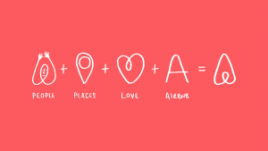
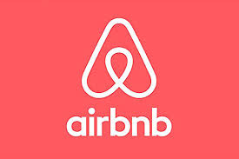

Airbnb changed the logo after it was value $10 billion
People
Place
Love
Airbnb
Airbnb New Logo
Bélo

Slide 24
Airbnb
Airbnb started with three broke students and an air mattress.
When they were in college, Brian Chesky, Joe Gebbia and Nathan Blecharczyk rented a mattress on their floor to strangers to make both ends meet.
From there, Airbnb has gone onto be valued more than $40 billion.
Their mission
To provide travellers with authentic experience and to foster a sense of belonging anywhere in a community of like-minded individuals.
Sales
Profit
Valuation
Booking Holdings | $3.3 billion | $1.3 billion Valuation $ 58 billion
Expedia Group | $2.7 billion | $478 million Valuation $ 8 billion
Airbnb | $1.1 billion | ($276.4 million) Valuation $ 40 billion
Tripadvisor | $335 million | $92 million

Slide 25
Learning from AirBNB Branding
1 – Keep People At the Centre – you learn from your own community.
2 – It’s Not Too Late to Find Your Story – continuously evolve.
3 – Content is the Key –The consistently post contents and their content is heavily user-driven and centres on stories from within the Airbnb community.

Slide 26
Branding
Brand represents what your company stands for and is the purpose of your company? How is your company going to connect with people? And why should people care?
“ If people believe they share values with a company, they will stay loyal to the brand.”
Brand connected strongly and emotionally with large customer base are regarded as of high brand equity. Strong brand equity gives pricing power.
A company with a strong brand equity can charge higher price than competitors for similar product and earn above average profit.

Slide 27
Brand
You want your customers to talk about it everywhere, every time, on dinner table, at public gathering, at home, at market place. You want your customers to be evangelists.
People must believe they receive values from your company, they should build trust in their mind, they should feel comfortable buying what you offer. Then they will stay loyal to the brand.
The connecting thread between the company and customers is the brand. Brand is the container of all the values you provide to attract and retain customers and the value for which you exist.
Brand may appear like a symbol or text. But it is the holder of everything that you want your customer to value in your offering.

Slide 28
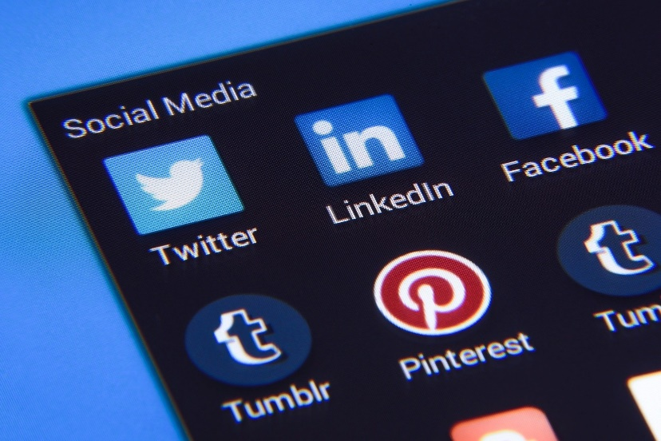
The Brand Symbol
A meaningful logo, color mix, a brand message or tagline aligning with your mission/vision.
It should transmit the message you want your customers to perceive about your product/service and company.

Slide 29
Public Relations
Michael Dubin stumbles upon a warehouse full of surplus razor blades
He started the Dollar Shave Club offer, Posted a YouTube video about the offer and launched on March 6, 2012.
The YouTube video attracted an unanticipated amount of traffic, that crashed the company’s server in the first hour. [It eventually had 25 million views]
Within 48 hours, they received 12,000 orders.
In 2016, dollar shaving club was acquired by Unilever for $ 1 billion.
What do you learn from this story?
An ordinary unemployed person is entrusted to find solution to a problem and he creates a unicorn without borrowing or taking huge investment. Michael would never think he had the entrepreneurial talent. But someone wanted help and he was forced to think of plausible solution. And an entrepreneur was born from nowhere. He converted a liability/CHALLENGE into a huge wealth/OPPORTUNITY.
https://www.youtube.com/watch?v=ZUG9qYTJMsI
Notes:
Dropbox was founded in 2007 by MIT students Drew Houston and Arash Ferdowsi as a startup company, with initial funding from seed accelerator Y Combinator.

Slide 30
Public Relations
. Drew Huston was confident about his idea. But nobody invested in him. Dropbox early MVP was just a video showing how the file sharing service is different from all other existing ones They received 10,000 plus signups in the first day.
Warby Parker’s PR firm helped place a story in Vogue—a piece that dubbed the company the “Netflix of eyewear” and generated so many sales that the startup ran out of inventory.
If those companies’ founders hadn’t decided to spread the word about their companies—each in their own way—they may have never become household names.

Slide 31
Public Relation
Many startups fail—even if they offer a great product or groundbreaking service—because they fail to get the word out.
They may think the product will sell itself – if we produce, it will sell.
People generally do not think rationally. They are mostly emotional and they eventually settle with a combination of rationality and emotional stimulation.
So superior value proposition and storytelling to resonate with the customers will only help win them.

Slide 32
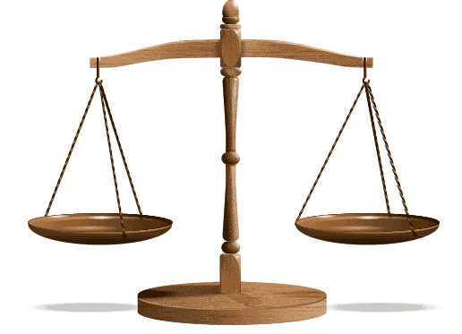
Make no mistake! Product-market-fit is the most important element for success. But the sooner potential customers get to know of the value proposition, higher is the success potential.
PR – Create Awareness
Product-market-fit

Slide 33
Advertising
Like PR, advertising is an outbound marketing to push your message out. But you’re not filtering it through a reporter.
The wonderful digital world offers boundless new opportunities to advertise in a cost effective way compared with the traditional media advertising, like billboards and TV, to Google AdWords and the latest social media advertising.
Like PR, it’s important to pick advertising destinations that engage your target market. Online advertising in particular can be incredibly granular—allowing you to laser-focus on the specific demographics and even the mindset of your target market.
Use of appropriate media depends on the type of targeted customers.

Slide 34
Content Marketing Strategy
Content marketing is about educating the customers.
is a strategic marketing approach focused on creating and distributing valuable, relevant, and consistent content to attract and retain a clearly defined audience — and, ultimately, to drive profitable customer action.
Leads to
Increased awareness and a deep sense of trust.
Increased sales.
Cost savings.
Increasing number of customers with strong loyalty.

Slide 35
Quality Content Is a Win-Win for Both
Instead of pitching your products or services, you are delivering information that makes your buyer more intelligent.
It helps buyers to make informed decisions and feel confident while making the purchase.
Through contents, businesses try to deliver consistent, valuable information to buyers, educate them of the pros and cons of features. They ultimately reward us with their business and loyalty.

Slide 36
Online Presence
Online presence is the conspicuous presence of a business that can be found via an online search.
Online presence management is the actions of presenting and drawing traffic to your brand online.

Slide 37
Online presence: to create a long-term positive presence for a business, or product in search engines and on the web in general.
The actions involves combination of
web design and development,
blogging,
search engine optimization,
pay per click marketing,
reputation management,
directory listings,
social media,
link sharing - get the word out about a product, service or brand.

Slide 38
Social Media Marketing
Social media marketing is the promotion of product or services through the use of social media platforms and websites.
Businesses can use online media platform to gather customer data, understand behavior, track customer retention in response to actions by the businesses, analyze data using AI, take corrective strategies, engage with customer for promotion.
Social media marketing can also be promoted through customers’ feedback mechanism.

Slide 39
What can you do to get connected?
Join all the big networks.
Write sensible comment on issues, display politeness, positivity and humor.
Like, share, connect and spread/expand your visibility.
Prepare compelling contents, Target specific audiences at first and build.
Use emojis — it helps make your image personal and human. Stats released by Adweek showed that 92% of people use emojis as they feel it expresses better than words do.
Most importantly, don’t pester — engage with users strategically

Slide 40
Marketing through Messaging or Messenger App
Message marketing is one-to-one conversations to build relationships with your audience unlike email marketing which is one-to-many messaging. Facebook IQ research finds that:
56% prefer to message rather than call a business.
61% are favorable to personal messages from businesses.
50% plus are more likely to shop with business they can message.
63% reported that their messaging with businesses is increasing.

Slide 41
Marketing through Messaging or Messenger App
Average email open rates is around 19 percent and click-through rates capped at around 2 percent.
For message marketing, open rate is greater than 80 percent and click-through rate is greater than 30 percent.

Slide 42
Focus on Engaging With Your Customers Rather Than Just Selling
It is necessary to engage with people to help to know more about your company and your products. Social media is the easiest way to engage with your target audience. Get involved in conversations and backlink your opinions to your product.
Let the customers notice you, understand your concerns about their satisfaction and, eventually, they will begin to trust your brand.
Be consciously very careful to be genuine, real and sober. Nobody will come back if you sound artificial or humbug.
Empower customer with information on features that they should know about. Let them know that you have their best interest in mind.

Slide 43
Engaging With Your Customers
Create a Niche and Build Credibility
Know and Share Your “Why”
Make your Content Easy to Discover
Frequently giveaway Samples
https://kickideas.com/how-to-marketing-your-startup-on-a-tight-budget/?gclid=Cj0KCQiA_rfvBRCPARIsANlV66M1Jci4iccqize00bgwYNXkmKSAQ0OL6WQTs-5mg-osI-2Aw_ose80aApYREALw_wcB

Slide 44
How much of what you have to do for furthering your business is to be discovered through experimentations and moving up the learning curve.

Slide 45
Thank you

Slide 46
Market Segmentation, Targeting and Positioning
Topic: Market Segmentation and Target Marketing
Lecture Note #: 13 03/10/2020

Slide 47
Three Steps to Know and Serve the Customers
Market segmentation
Target marketing / market niche
Product or Service Positioning
Influencer marketing
Hype before launch – start with escape velocity

Slide 48
Segmentation
The mission is the statement of purpose for which an organization exists.
Mission contains information on the customers the company serves, the products and services it provides and the unique value proposition differentiating it from the competitors.
Mission and market are, thus, inextricably associated.
Marketing management, therefore, begins as the idea of the startup germinates.

Slide 49
Segmentation
The most critical event in an enterprise is the one when customers pay money in exchange for products or services.
Even before we start designing a product, we need to know who our customers are.
We define a clear persona of our customers delineating their unique characteristics, taste, choices, behavior, aspirations and pains.
This helps us to identify a homogenous group of people, though, they may be spread over a vast geography.
This homogenous group of people constitutes the segment.

Slide 50
Segmentation
Once we define the persona, we can customize our products or services to best suit our target customers.
We can now identify the media for creating awareness that is visible to our specific group of customers.
We can choose the channel for selling and delivering the product as preferred by them.
Since we know the customer persona, deciding on the promotion process should also be easy.
We want to pay close attention to our customers to keep them happy so that they remain loyal to our brand (positioning) for a long time to come.

Slide 51
Market Segment
Is a subset of the market consisting of those people or businesses among the entire people or businesses in the market who have similar likes, dislikes, taste and aspirations, similar pains and look for similar solutions, similar needs, and affordability.
Market segment is identified for the purpose of understanding particular unmet pain in any group of people and developing solution to alleviate the unmet pain in a manner that would be regarded as superior value for money.
Segmentation is the process of dividing the total market of heterogeneous customers into subgroups of homogenous customers with similar needs, wants and aspirations concerning a particular type of product or service.

Slide 52
The story of the 10 Carat Gold Jewelry
Understanding Market Segment
Indians love gold jewelry.
Gold price has gone up and has remained at an elevated level for a long time. The making charge of an ornament is some percentage of the price of the gold, which has made it even costlier.
You are exploring the idea of 10 carat gold jewellery.
These jewellery have less gold (close to 10 parts Gold and 14 parts other metals such as copper, zinc, silver or nickel).
Therefore, they are cheaper, though they look good and remain shiny for a long time, like gold.

Slide 53
The story of the 10 Carat Gold Jewelry
Understanding Market Segment
With increasing price of gold you presume that people would prefer to buy these jewellery.
You have decided to manufacture and sell 10 carat gold jewelry.
You are planning to set up a mechanized manufacturing facility with an investment of Rs. 1 crore.
You have identified a village with 500 households (families) to start marketing.
You want to directly approach to the families.

Slide 54
The story of the 10 Carat Gold Jewelry
Understanding Market Segment
You have two options
Option 1: Go and meet all the households to sell the jewelry
You start from one end of the village and move to the other end.
This may take more than a month to cover the whole village.
May cost huge sums of money to communicate and meet.
Engage manpower for a long time leading to opportunity cost.
Eventually you may find that only a few families are your actual customers.

Slide 55
The story of the 10 Carat Gold Jewelry
Understanding Market Segment
Option 2: Identify those who are most likely buyers of your products
You know the profile of families who are your likely customers.
You collect demographic data on the population of the village.
Identify families with middle to high income.
Out of those, identify families with women in the age-group of say 18 to 60 years.
Attend this smaller group of families.
You can see the benefit of identifying the people who are potential customers. So you adapt the option 2.

Slide 56
120 families
1. Gold Jewelry of 10 Carat
2. Silver jewellery

Slide 57
The story of the 10 Carat Gold Jewelry
Understanding Market Segment
You send brochure containing nice pictures of variety of products to these prospective families.
In the process, you create awareness of your products and people start discussing about them and aspiring to have them.
You send letters to families intimating that a representative will come to demonstrate. You announce special discount for inaugural sale.
You complete meeting all the prospective families in a week.
You are likely to close deals with majority of the families you attend.
You save time and resources for achieving the same success as in approach 1.

Slide 58
The story of the 10 Carat Gold Jewelry
Understanding Market Segment
What do we learn from the story?
The village has heterogeneous families in terms of income and demography. Many are not your potential customers.
You want to avoid wasting time approaching to families with remote chance of being interested in your products―at least not in the early stage.
So you have shortlisted the families those you think can be your customers.
These families are homogenous from the perspective of the needs of your product, though they may be heterogeneous from many other aspects.
Thus, segmentation is done to identify a homogenous group of persons out of a heterogeneous population (or entities in case of B2B business model) with needs and aspirations that your product or service can fulfill. They are your potential customers.

Slide 59
Market Segmentation: Definition
The process of creating a homogenous sub-group of people based on criteria suitable for marketing a particular product or service out of a heterogeneous population is segmentation.

Slide 60
Market Segment us Product Specific
Consider the market of the same village in the example cited above, the segment would change if you are planning to sell low-cost detergent or lower-end body soap, male dresses, or say insecticide.
Therefore, the concept of homogenous group is in direct reference to a product.
Any population can be broken into many homogenous subgroups, i.e. segments, depending on what you are trying to market.

Slide 61
By segmenting the market,
The story of the 10 Carat Gold Jewelry
You have reduced
the cost of sending letters so as to make them aware of the nice jewelry at such low cost,
the cost of communicating about availability at the door step,
and cost of reaching the customers – a smaller group of families.
It has now become easier to manage them; particularly to serve them better.
You can get feedback from them easily and add or remove features/ designs that the majority do not like.

Slide 62
Why Segmentation?
To be able to address a small but relevant group of customers and exclude those who are not potential customers.
To identify unmet pain.
To understand the size of the market and growth potential.
To be able to understand the pain.
To understand types of existing solutions offered by competitors.
To understand the features/parameters of a better solutions.

Slide 63
Why Segmentation? …Contd.
To assess the entry barrier and competitive landscape.
To explore developing such a solution at competitive rate and offer a superior value proposition.
To understand whether the proposed solution is really appreciated by the segment and the customers would buy at the desired price.
To understand the channel for reaching out to the customer, making the product/service available and reaching the product to them.
Save money on channels to create awareness, logistics, and delivery.

Slide 64
Basis of Segmentation
Geographic
Demographic
Behavioural
Psychographic
Region
Climate
Market density
Market size
Gender
Income, Age & Lifestyle
Occupation
Marital status
Socio-economic group, Ethnicity
Education, Religion
Readiness to purchase
Attitude
Rate of usage
Benefit sought
Loyalty status
Lifestyle
Personality
Belief
Values
Example: Customers in area of snowfall
Example: Newly married women
Example: Active in social media
Example: Vegetarians

Slide 65
Total Available Market (TAM)
Serviceable Available Market (SAM)
Serviceable Obtainable Market (SOM)
Total demand of the product in the entire market
Market Segment and Target Market
Demand of the product among the segment that is within your geographical reach
Portion of the demand that you aim to capture

Slide 66
Use of TAM, SAM, SOM
Make fair assessment of the market size to be targeted.
Making meaningful sales projection.
Valuation of startups.
Estimate investors’ returns.

Slide 67
Market Segment and Target Market: Example
TAM
Total Addressable Market (TAM) – understand market size & growth
Middle income household jewellery market in India : Say ₹1,00,000 Crore
SAM
Serviceable Available Market (SAM): Target market – know market structure
Middle income household jewellery market in the target village: ₹10 cr
SOM
Serviceable Obtainable Market (SOM) – market size to target
You target to capture 10% of the jewellery market of middle income household in the village in two years: ₹1 cr

Slide 68
Positioning
You want to provide a product that appeals to your target customers.
You already know what attributes the customers are interested in.
You also know which of these attributes of your product are better than those in competing products.
Say you are selling motorcycles. Attributes such as fuel efficiencies, acceleration, maximum speed, safety, style, sporty or adventurism etc. are of concern for customers.
Ultimate goal of positioning is to serve the unmet needs of the market. You serve it better than competitors and your product will sell.
For the 10 carat jewelry, classical design and modern design may be liked by different persons.

Slide 69
Positioning/ Brand positioning
Features of the product
Features of the product
Where you are strong
What customers want
Ideal
Positioning
Examples of Brand Positioning
Colgate is positioned as protective.
Patanjali claims to be fully organic.
Sensodyne targets tooth sensitivities.
Dabur – natural & Ayurvedic (psychographic)
Pepsodent – complete family
Woodland is tough and perfect for outdoors.
Coca-Cola brings happiness.
Axe deodorants have a sexual appeal.
Risky
Features of the product
Competition positioning
No go zone
Clove
Where competitors are strong

Slide 70
Positioning
The 10 carat gold jewellery is affordable by the targeted people.
The jewellery looks like real gold and they do not have the cheap impression of imitation.
You provide value for money and do not compromise on esteem associated with jewellery.
Therefore, you create a positive and attractive image of your product in the minds of the customers.

Slide 71
Positioning …continued
You maintain the quality you assure and keep the promises you made providing a happy feeling about your company or the brand in the minds of the customers.
Assure exchange value with minimum loss.
In the process you get loyal customers who build a bond with your products. This process of creating a favourable image of a product or service in the minds of targeted customers is known as positioning.
Your customers prefer your products over those offered by competitors and spread positive message to others. Soon your brand becomes a household name.

Slide 72
Process of Product Positioning
Know your customers well.
Know the competing products or services.
Create differentiators that you can use as unique selling proposition.
Convey the superior value proposition to create awareness.
Launch promotional scheme to convert ‘willingness to buy’ to ‘execute purchase’.
Maintain the value and constantly improve to remain ahead of competition.

Slide 73
Target marketing

Slide 74
Target Marketing
While selling the 10 carat jewelry, you will realize that the choices of young girls are different from those of the matured women.
You have to have products that suit the moods and aspirations of each such group within the broad market segment.
That will help you to attract all sub-groups of customers with fascination towards specific nuances.
Strategy to meet the differentiated needs and aspiration of different groups of customers by customizing solutions to fit their unique requirements is target marketing.

Slide 75
Target Marketing Steps
Segment The Market: Segment your business’s serviceable market according to any of the demographics, geographic, psychographics, and behavioural patterns.
Analyze the Unique Needs of your Customers: Know what the customers value most and what the competitors lack.
Analyze Competition Landscape: What are their value proposition, how are they attracting, acquiring and retaining customers?
Identify Your Differentiators: Your superior value proposition differentiates you from the competitors. It is why the customers will prefer your product over others.
Promote: Introduce promotional schemes that is viewed as attractive by the target customers.

Slide 76
Target Marketing
Target market / market niche
Target a niche within segment (a place within a market segment that represents a narrower group of customers with similar interests but with some fineness.)
Understand the specific needs.
Meet its customers’ specific needs.
You solve specific problem of a niche market.
Provide customers with wholesome satisfaction and unique experience.

Slide 77

Marketing Mix
The marketing mix refers to the set of constructs and actions, or tactics, that a company manoeuvres to promote its brand or product in the market.

Slide 78




Marketing Mix Variables are
Product, Price, Place, and Promotion – the four Ps of marketing
Product
Price
Place
Promotion

Slide 79
Marketing Mix
Price
Promotion
Product
Place
The marketing mix is a business tool used in marketing and by marketers.
The marketing mix is often crucial when determining a product or brand's offer, and is often associated with the four Ps: product, price, place, and promotion.
The marketing mix refers to the set of actions, or tactics, that a company uses to promote its brand or product in the market.
Marketing Mix
Target market

Slide 80
Marketing Mix
Product
Price
Place
Promotion
Customer Solution or pain reliever.
Customer Cost.
Communication & delivery.
Convenience.

Slide 81
Marketing Mix: Components & Functions
Price
Promotion
Product
Place
Pricing strategies
Discount
Payment terms
Bundle offer
Differentiators
Product-market-fit
Quality, efficacy
Packaging
Branding
Warranties
Marketing Mix
Target market
Promotion through:
Advertising
Public relation
Social network
Content marketing
Promotion schemes
Channels to customers
Delivery & payment
Purchase
Transport
Aftersales support
Geographical coverage

Slide 82
Growth Hacker Marketing
It is possible to start a company on a shoestring budget and create product that customers will love.
New generation companies such as Facebook, Dropbox, Airbnb, Twitter have not been spending a dime on traditional marketing.
They do not advertise on TV, no billboards, no newspaper ad.
They rely on a new strategy — growth hacking — to reach many more people despite modest marketing budgets.
Growth hackers have thrown out the old playbook and replaced it with tools that are testable, trackable, and scalable.
They believe that products and businesses should be modified repeatedly until they're primed to generate explosive reactions.

Slide 83
Growth hacking
A new marketing tool to achieve rapid growth on small budget.
Growth hacking helps to acquire many users at a nominal cost.
A team usually involve marketers, developers, engineers and product managers.
The growth hacker often use social media, viral contents, content marketing, influencers.
They build a story that resonate with customer’s emotion.
It must be supported by a compelling product-market-fit in order for retaining the satisfying customers once acquired leading to a viral loop of evangelists – a self-promotional model.

Slide 84
Growth Hacking
It reduces customer acquisition cost, help increasing margins, ease of product extension, and promote long term sustainable growth. Else, you will pour water in a leaky bucket.
growth hacking uses iterations to rapidly test persuasive copy, email marketing, SEO and viral strategies, to increase conversion rates and achieving rapid growth of the user base.
Techniques such as search engine optimization, website analytics, content marketing and A/B testing are used.
Growth hacker use validated learning with the help of minimum viable product.

Slide 85

Growth Hacking
Growth appears like a magic wand: as if growth is the end (success).
This can be one of the greatest of mistakes in startup marketing.
The product-market-fit, positioning the product to the target customers and meeting their exact needs better than competitors, vibrant sales funnel are indispensable.
Premature growth may ruin your business and waste your resources.
While you celebrate the growth, you may suddenly fall over the precipice.

Slide 86
How fast to grow?
Every decision that a growth hacker makes is driven by seeking measurable growth.
Vanity metrics do not indicate anything (!!!) towards a profitable and scalable business.
Create a viral loop
Choose the right growth engine
Leverage everywhere including marketing

Slide 87
Viral Loop
You must be able to make your customers do the advertisement of your products to their friends (word-of-mouth advertisement or referral).
Your customer acquisition cost will be minimized and you will soon move towards profitable business.

Slide 88
Growth Hack, Vanity Metrics, and Strategies
01
Constantly review your sales funnel
Upgrade the sales funnel to create a viral loop so customers spread your message
02
Be cautious and do not follow vanity metrics. Check if it is leading to long-term value.
Check the customer acquisition cost and how quickly the cost is recoverable.
03
Define sales funnel metrics.
Are the increasing number of foot-fall getting translated into profitable sales?
04
Estimate possible virality effect
Plan, execute and measure virality to achieve real growth.
05
Update marketing plan
Put appropriate information system to collect and process data to monitor the metrics

Slide 89
Influencer Marketing
The process of creating awareness and trust on your brand through endorsement by internet celebrity or other persona.
It involves unique contents and paid media. Thus, it is a hybrid of traditional advertisements and content marketing using the internet.
Influencer are usually anybody with a large fan-following and need not be an entertainment celebrity. It can be an ordinary person with YouTube channel showing particular popular knowledge. The person can endorse a particular product just by using it in his/her content. So, it becomes natural choice for the viewers to trust that brand. Thus, influencers may be product-specific.
https://www.nytimes.com/2019/03/01/business/media/social-media-influencers-kids.html
Notes:
People have grown cynical toward advertisements. They say it shows up in every conceivable place, makes ridiculous claims, plays to our most base instincts, and crowds out things that are more interesting and essential. In a world where brands are making incredible claims and counter-claims, it is hard to trust any of the claims that marketers make. This cynicism is often eroded when a seemingly known person recommends a particular brand. The trusted source may be just a casual acquaintant on the social media. If the same

Slide 90
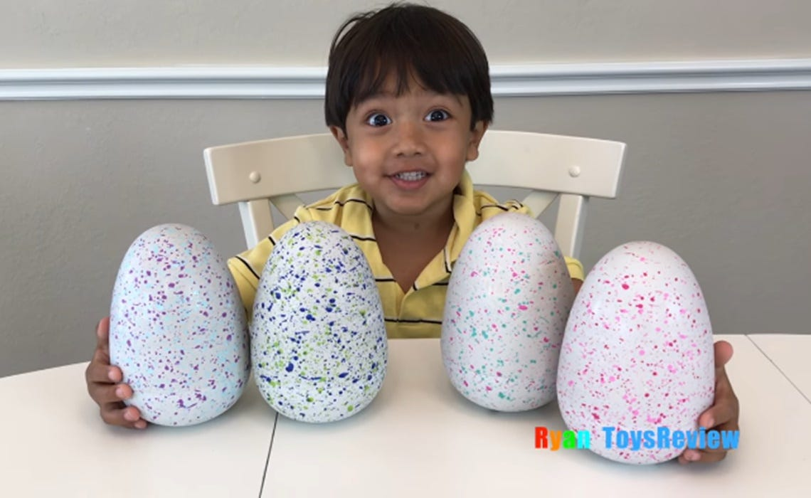
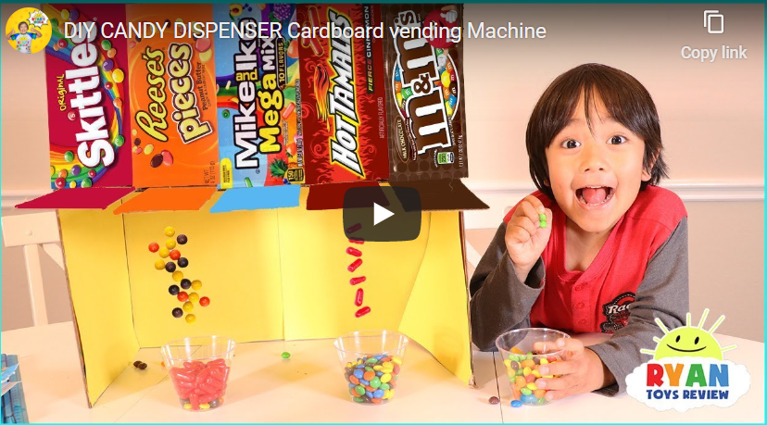
A 7-year-old boy is making $22 million a year on YouTube reviewing toys
Surely the envy of elementary-school kids worldwide, the YouTube star reviews new toys in videos that his family produces. Ryan ToysReview took the No. 1 spot this year (2018) on Forbes' annual list of the highest-earning YouTube accounts, up from 8 last year.

Slide 91
Hype before launch so that your customer start buzzing on social media
A video teaser
Give a sneak-peak
Tell a captivating story – say you start a chain of coffee shops
Create a hashtag (catchy) for interested people to follow the developments and invite them to retweet the hashtag.
Be creative on a promotional schemes.
Start a Blog
A short video in the youtube: Video shows visuals and is effective [dollarshavingclub, dropbox)
Influencer : Reebok with Chetan Bhagat
Yezdi bike
Mahindra Thar
Apple iPhone
Notes:
Let your product blasts off into the space

Slide 92
People at large/
Whole market
Awareness
Market segment
Prospect
Interest
100
Consideration
Lead nurture
75
Intent
50
Evaluation
Sales
25
Purchase
Output
Reference
Virality

Slide 93
Brant Cooper and Patrick Vlaskovits (2010) The Entrepreneur’s Guide to Customer Development
Steve Blank (2013) The Four Steps to Epiphany
Brant Cooper and Patrick Vlaskovits (2013) The Lean Entrepreneur: How Visionaries Create Products, Innovate with New Ventures, and Disrupt Markets by Brant Cooper
Simona Covel - Marketing Your Startup_ The Inc. Guide to Getting Customers, Gaining Traction, and Growing Your Business (2018, AMACOM)
https://blog.globalwebindex.com/marketing/brand-storytelling/
http://www.flaticon.com/free-icon/ for various icons downloaded free

Slide 94
Thank you

